Slide 1

NONRENEWABLE
AND
RENEWABLE
RESOURCES

Slide 2


HMMMM....
What do you think nonrenewable resources are?
Break it down...
Nonrenewable?
Resource?

Slide 3
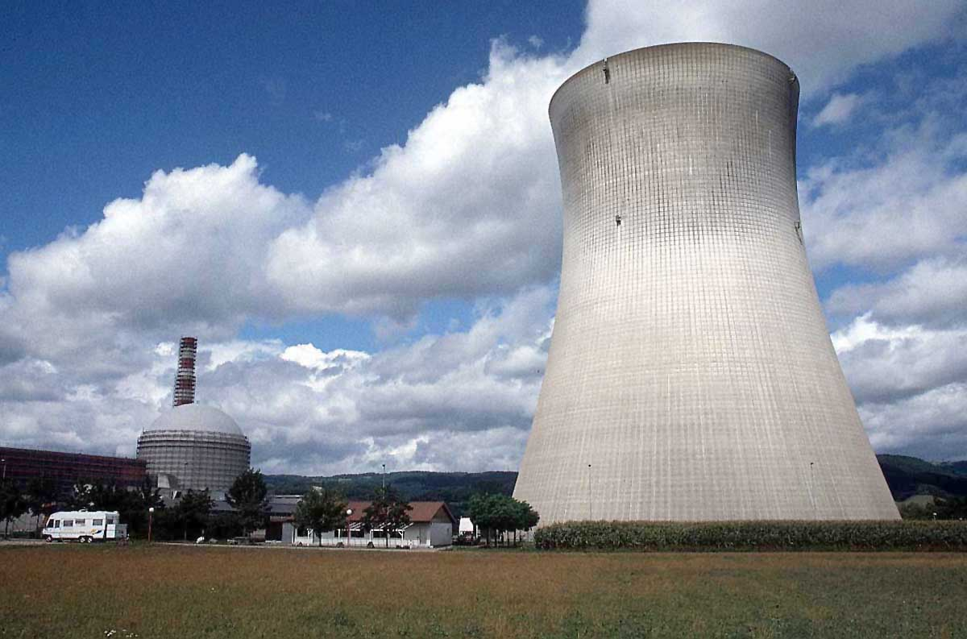
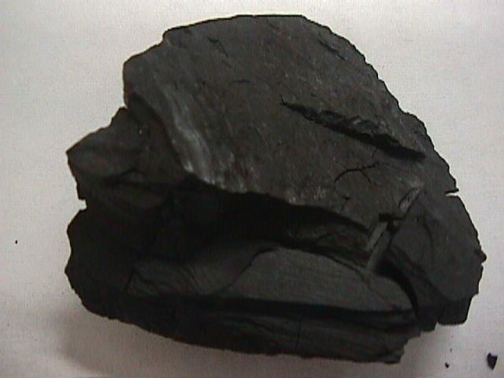
NONRENEWABLE RESOURCES
A nonrenewable resource is a natural resource that cannot be re-made or re-grown at a scale comparable to its consumption.

Slide 4
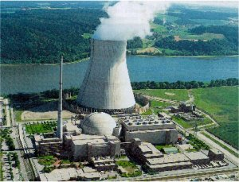
NUCLEAR ENERGY
Nuclear fission uses uranium to create energy.
Nuclear energy is a nonrenewable resource because once the uranium is used, it is gone!

Slide 5
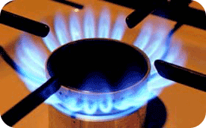

COAL, PETROLEUM, AND GAS
Coal, petroleum, and natural gas are considered nonrenewable because they can not be replenished in a short period of time. These are called fossil fuels.

Slide 6
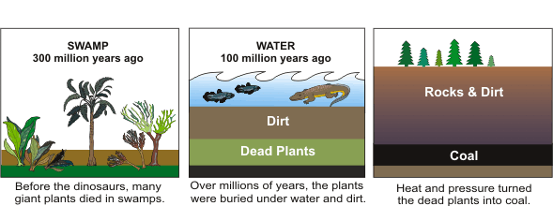
HOW IS COAL MADE ???

Slide 7
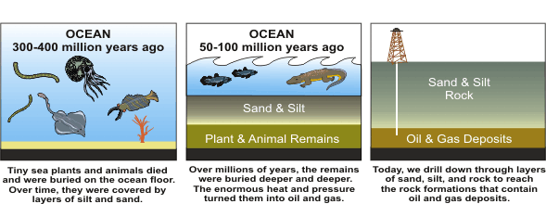
HOW ARE OIL AND GAS MADE ???

Slide 8
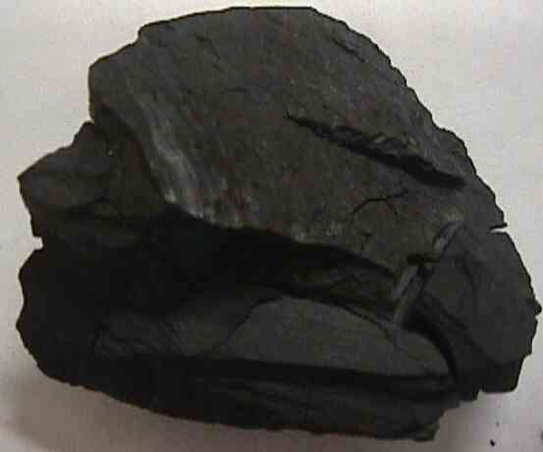

WHAT WAS THE DIFFERENCE BETWEEN COAL AND OIL/GAS?

Slide 9
HMMMM....
If nonrenewable resources are resources that cannot be re-made at a scale comparable to its consumption, what are renewable resources?

Slide 10

RENEWABLE RESOURCES
Renewable resources are natural resources that can be replenished in a short period of time.
● Solar ● Geothermal
● Wind ● Biomass
● Water

Slide 11

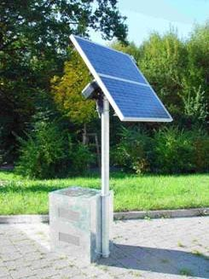
SOLAR
Energy from the sun.
Why is energy from the sun renewable?

Slide 12
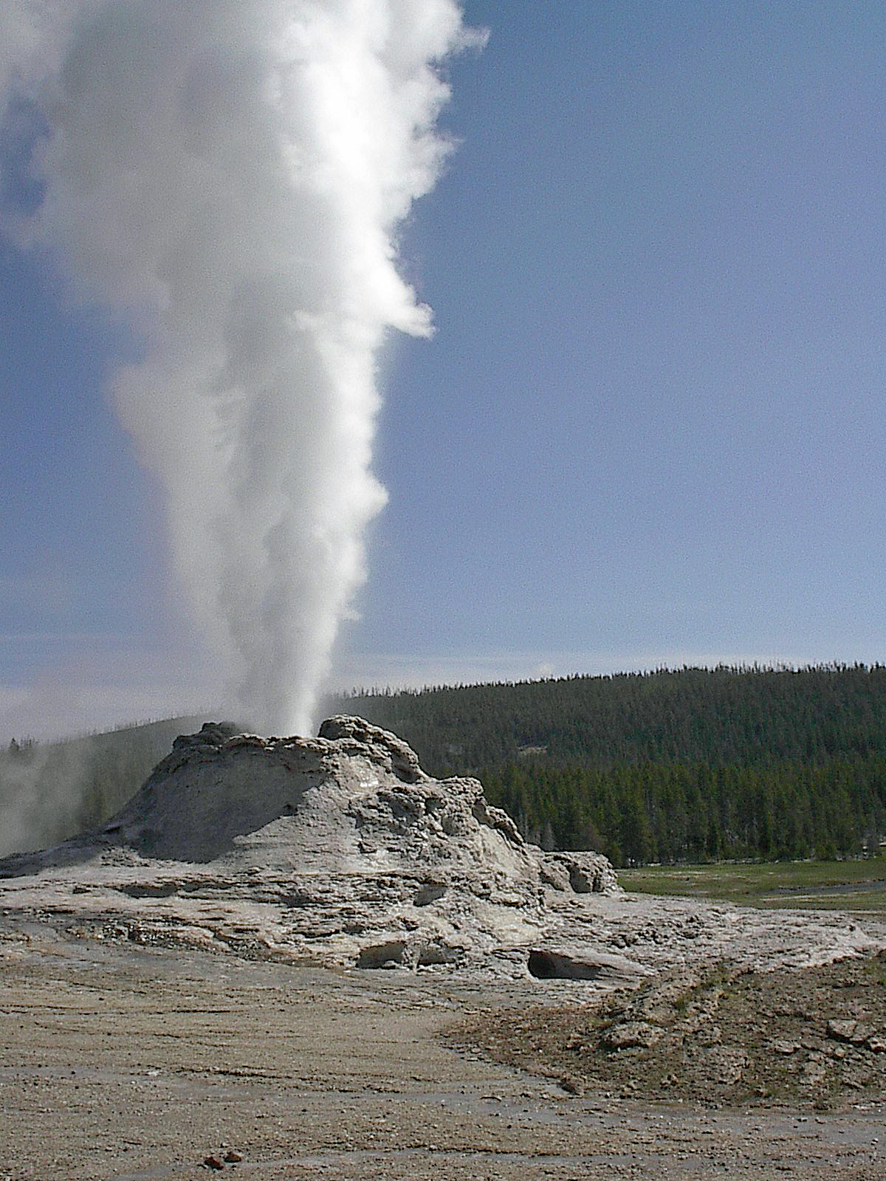
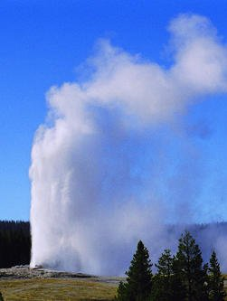
GEOTHERMAL
Energy from Earth’s heat.
Why is energy from the heat of the Earth renewable?

Slide 13

WIND
Energy from the wind.
Why is energy from the wind renewable?

Slide 14

BIOMASS
Energy from burning organic or living matter.
Why is energy from biomass renewable?

Slide 15
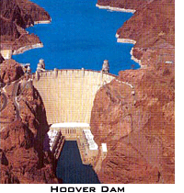
WATER or HYDROELECTRIC
Energy from the flow of water.
Why is energy of flowing water renewable?

Slide 16

SUMMARY
What are the differences between nonrenewable and renewable resources?

